Slide 1

Event Closing

Slide 2
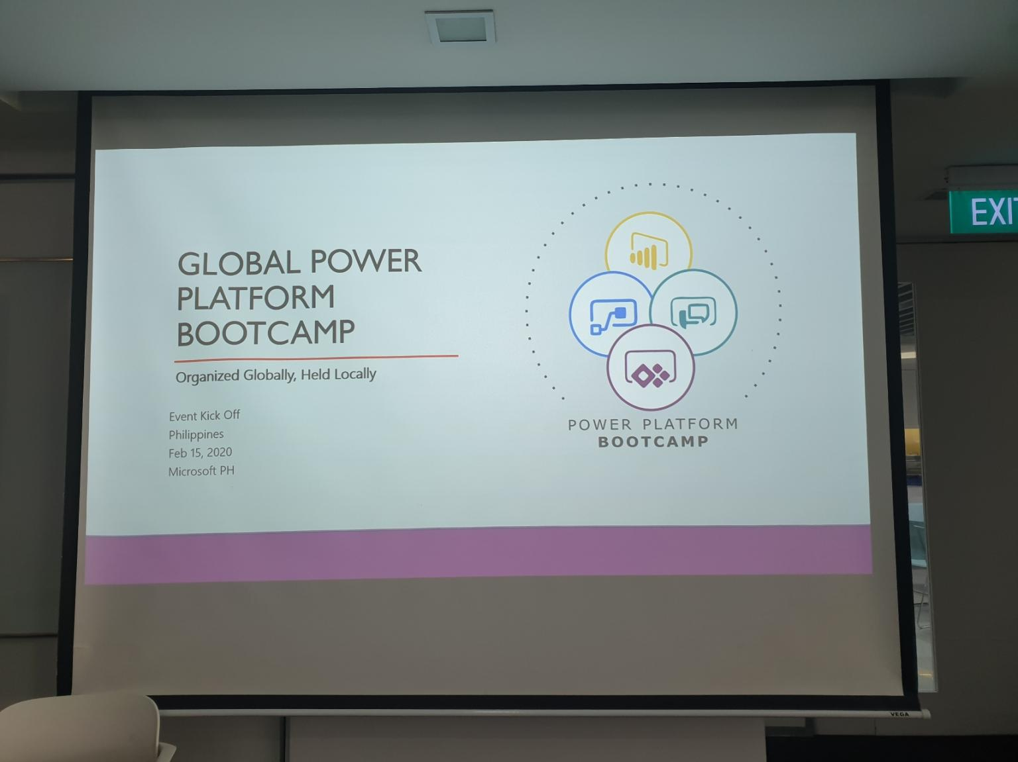
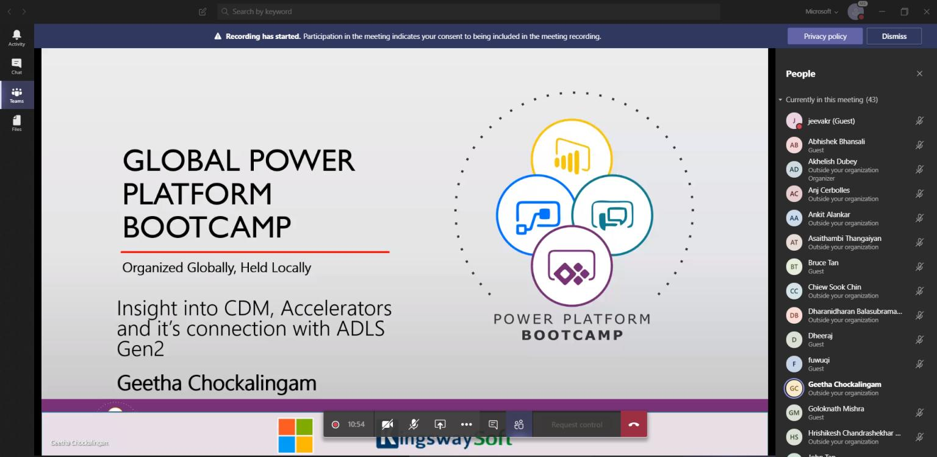
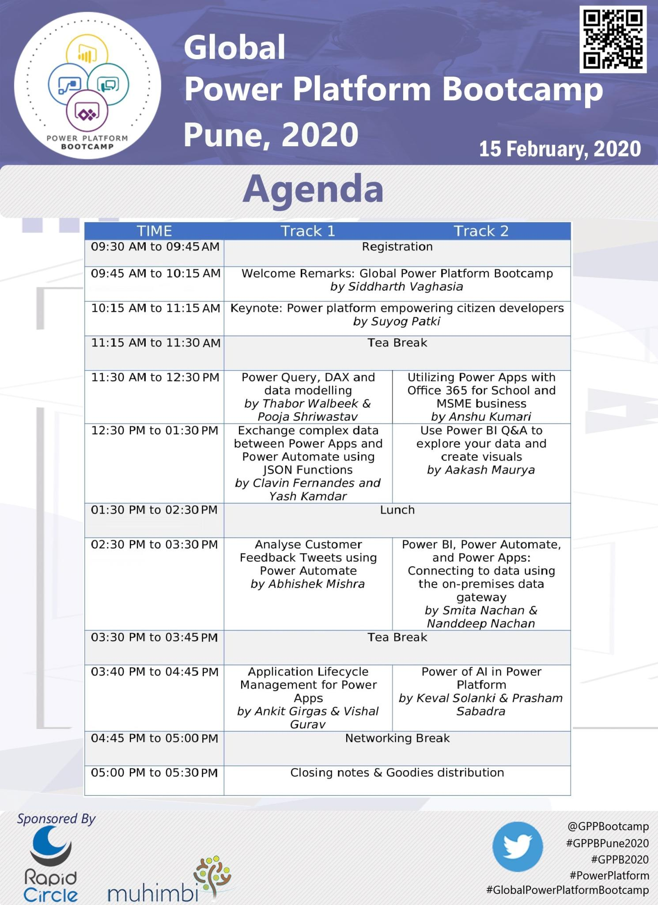

Slide 3
Extra Material
Slides
https://github.com/ramimounla/GlobalPowerPlatformBootcamp
Flow in a day
https://github.com/Power-Automate-in-a-day/Basic-Training
App in a Day
http://aka.ms/appinaday
Dashboard in a Day
http://aka.ms/diad

Slide 4
Thanks To Our Local Sponsor’s

Slide 5
Social Media
Our Hashtags:
#GlobalPowerPlatformBootcamp
#GPPB2020
Twitter Handle: @GPPBootcamp
Share Pictures, videos and content: http://bit.ly/GPPBShare
Notes:
Lets Hear from the Global Team, Play video

Slide 6
THANK YOU!

